Slide 1


The Landscape of Artificial Intelligence
Artificial intelligence (AI) has become a ubiquitous force in today's world, reshaping industries and revolutionizing how we live, work, and interact with technology. But what exactly is AI, and how does it differ from its various subfields? This presentation explores the multifaceted world of AI, from its core concepts to its cutting-edge applications.

Slide 2
Navigating the AI Spectrum
Understanding the various facets of AI is crucial for navigating the rapidly evolving world of artificial intelligence.
1
Artificial Intelligence (AI)
2
Machine Learning (ML)
3
Deep Learning (DL)
The overarching field encompassing the development of intelligent machines capable of performing tasks typically requiring human intelligence.
A subset of AI focused on training computer systems to learn from data without explicit programming, enabling them to adapt and improve over time.
A specific type of machine learning that uses artificial neural networks with multiple layers to extract complex patterns and features from data.
4
Generative AI
5
Applied AI
A branch of AI that focuses on creating new content, such as text, images, music, and videos, using algorithms to learn from existing data and generate novel outputs.
The practical implementation of AI techniques across various industries and domains, ranging from healthcare and finance to manufacturing and transportation.

Slide 3
The Quest for Artificial General Intelligence
Artificial General Intelligence (AGI), often referred to as strong AI, is a hypothetical form of AI that possesses human-level intelligence and the ability to learn and perform any intellectual task that a human can.
Step 1: Building a Foundation
1
Developing sophisticated AI systems that can process information, learn from data, and solve complex problems.
2
Step 2: Embracing Cognitive Capabilities
Expanding AI systems to encompass a wider range of cognitive abilities, including reasoning, problem-solving, and decision-making.
Step 3: Fostering Creativity and Imagination
3
Enabling AI systems to generate novel ideas, explore different possibilities, and think outside the box.
4
Step 4: Achieving Consciousness and Self-Awareness
A highly debated area, this involves developing AI systems that possess consciousness, self-awareness, and subjective experiences.
Step 5: Transcending Human Capabilities
5
Reaching the ultimate goal of super-intelligence, where AI systems surpass human intelligence in all aspects, with the potential to solve global challenges and reshape society.

Slide 4
Training and Inference: The Heart of AI
AI systems learn and perform tasks through two fundamental processes: training and inference.
Training
Inference
Hardware Acceleration
Involves feeding the AI system with vast amounts of labeled data to enable it to learn patterns, relationships, and rules. This process is iterative and involves adjusting the system's parameters based on its performance on training data.
Once the AI system is trained, it can use its learned knowledge to make predictions or decisions on new, unseen data. Inference involves applying the trained model to input data and generating an output based on its learned patterns.
GPUs and neural engines are specialized hardware designed to accelerate the computationally intensive tasks involved in training and inference. Their parallel processing capabilities enable significantly faster processing times, making AI models more efficient and scalable.
Supervised Learning
Classification
Unsupervised Learning
Regression
Reinforcement Learning
Clustering

Slide 5
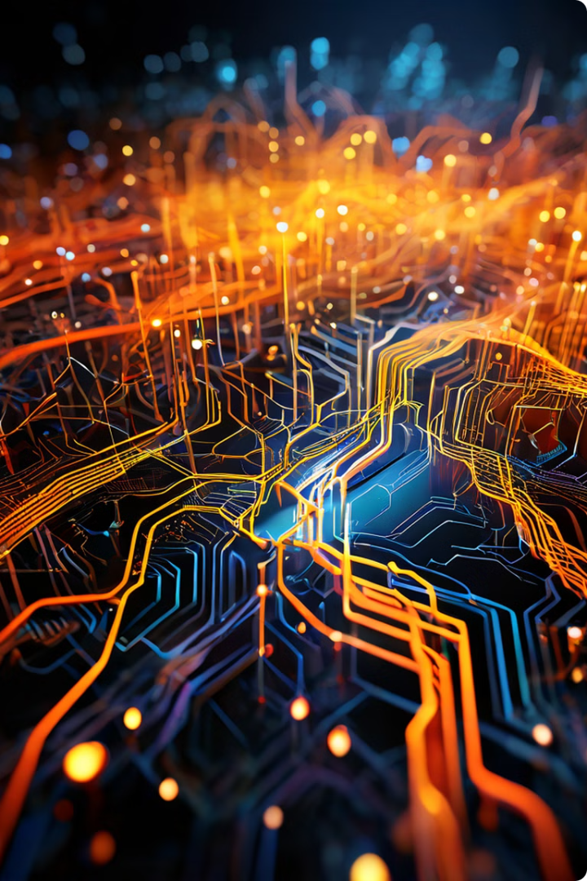
Neural Networks: The Building Blocks of Deep Learning
Neural networks are a core concept in deep learning, inspired by the structure and function of the human brain.
Nodes
Layers
Represent individual neurons in the network, responsible for processing and transmitting information.
Organized groups of nodes that perform specific operations, such as feature extraction or classification.
Parameters
Tokens
Adjustable values within the network that determine the strength of connections between nodes and influence the network's output.
Represent individual units of information, such as words in text or pixels in images, that are processed by the network.

Slide 6
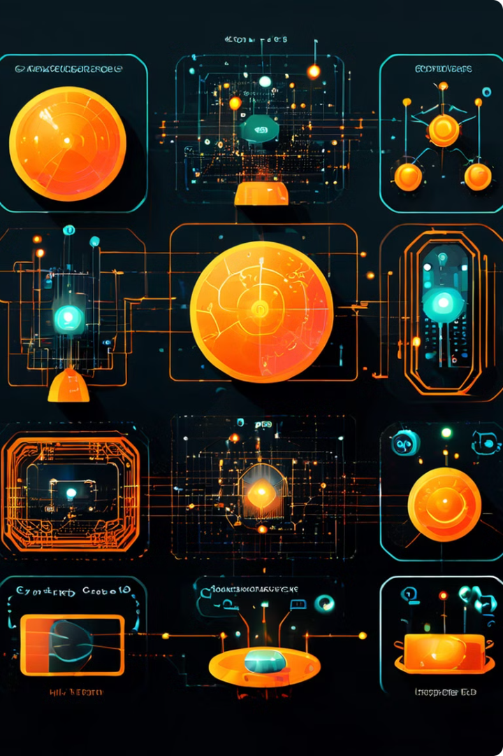




Unlocking the Power of Neural Networks
Neural networks are powerful tools for tackling complex AI tasks, but their effectiveness relies on careful training and optimization.
Image Recognition
Natural Language Processing
Classifying and identifying objects in images, enabling applications such as self-driving cars and medical diagnosis.
Understanding and generating human language, powering applications such as machine translation, chatbots, and text summarization.
Music Generation
Game AI
Creating original music compositions, exploring new musical styles, and enhancing creative expression.
Developing intelligent game characters, creating challenging opponents, and enhancing the gaming experience.

Slide 7
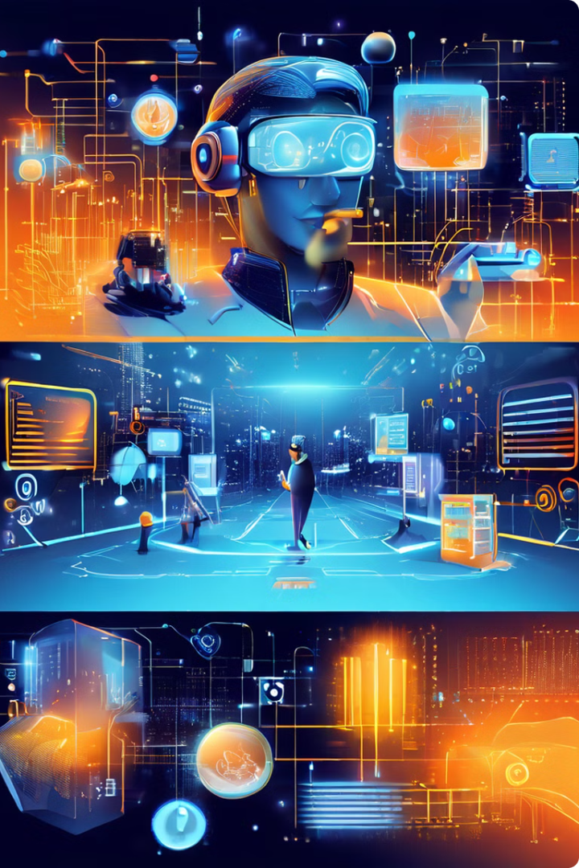




AI Beyond the Hype: Real-World Applications
AI is no longer a theoretical concept; it is being actively applied across various industries, transforming the way we live and work.
Healthcare
Diagnosing diseases, personalizing treatment plans, and improving patient care.
Finance
Detecting fraud, managing risk, and providing personalized financial advice.
Manufacturing
Optimizing production processes, predicting equipment failures, and improving quality control.
Retail
Personalizing customer experiences, recommending products, and optimizing inventory management.

Slide 8
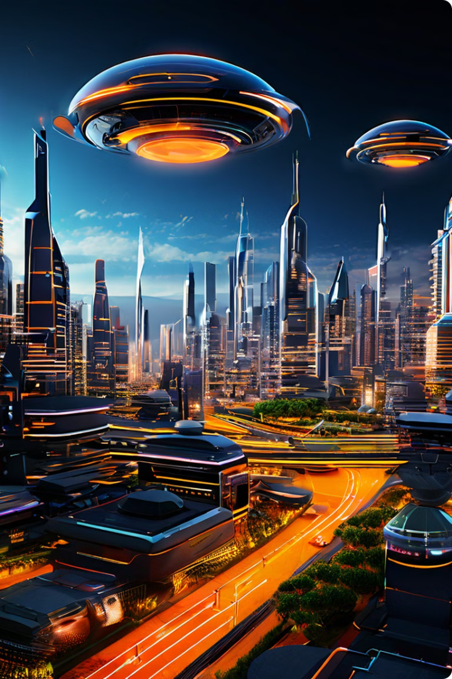
The Future of AI: A World of Possibilities
AI continues to evolve rapidly, with new advancements and applications emerging constantly. The future holds immense potential for AI to address global challenges, improve our lives, and create a more sustainable and equitable world.
AI for Sustainability
Developing solutions for climate change, renewable energy, and environmental protection.
AI for Education
Personalizing learning experiences, enhancing student engagement, and improving educational outcomes.
AI for Social Good
Addressing societal issues such as poverty, inequality, and healthcare access.

Slide 9
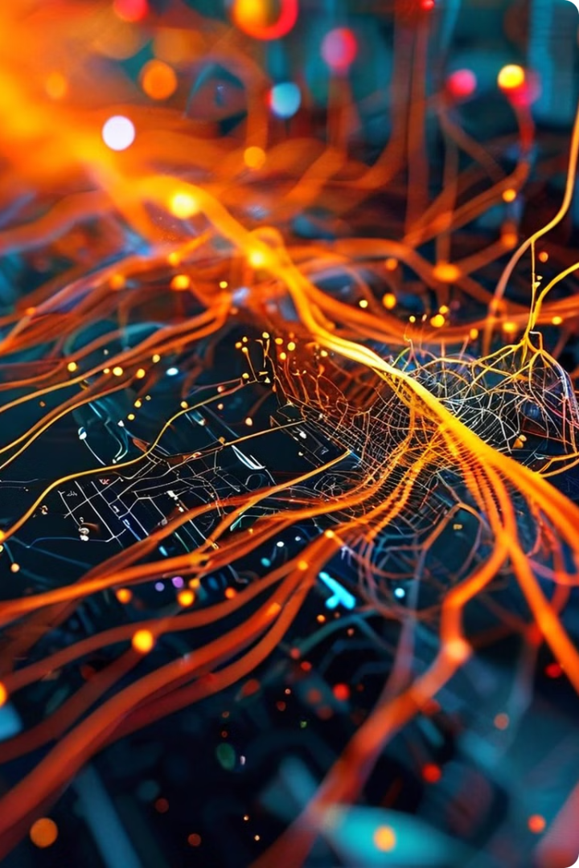
Deep Learning: A Glimpse into the Landscape
The field of deep learning is rapidly advancing, powered by innovative architectures and powerful models. These models are revolutionizing how we interact with data and solve problems.

Slide 10
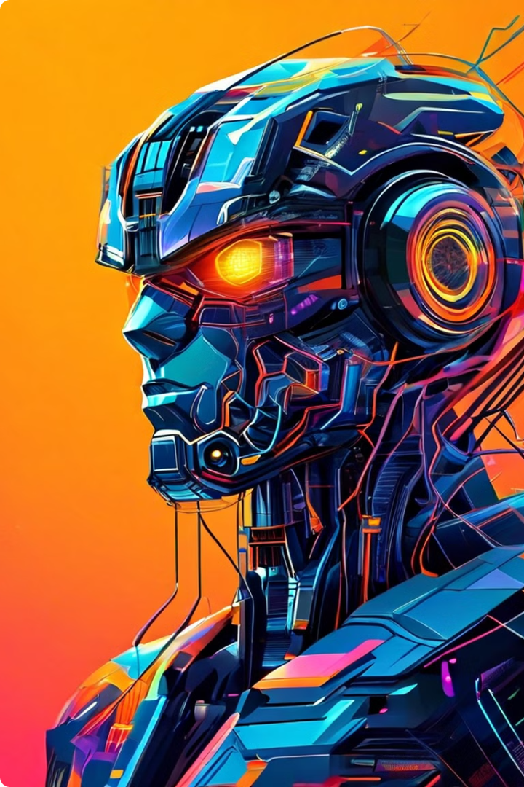
Transformers: The Architecture of Choice
Transformers are a type of neural network that have revolutionized Natural Language Processing (NLP). They utilize self-attention mechanisms, allowing the model to understand long-range dependencies in data.
1
Transformers
2
Generative Adversarial Networks (GANs)
Transformers have become the dominant architecture for language models, surpassing traditional recurrent neural networks (RNNs) in many NLP tasks.
GANs are a powerful tool for generating realistic images, audio, and other types of data. They consist of two competing networks: a generator and a discriminator.
3
Variational Autoencoders (VAEs)
4
Long Short-Term Memory (LSTM) Networks
VAEs are a type of generative model that learns a latent representation of the input data. They are often used for data compression and generation.
LSTMs are a type of recurrent neural network specifically designed to handle sequential data. They excel at tasks like machine translation and speech recognition.

Slide 11
Large Language Models (LLMs): A New Era in AI
Large Language Models (LLMs) are trained on vast amounts of text data, enabling them to understand and generate human-like language. They have become the foundation for many AI applications.
Open-Source LLMs
Closed-Source LLMs
Hallucinations
Open-source LLMs are freely available for anyone to use and modify. This promotes research and allows developers to build custom applications.
Closed-source LLMs are proprietary and controlled by specific organizations. They often have advanced capabilities but require licensing for use.
Hallucinations occur when LLMs generate outputs that are not factually correct or relevant to the input. This can be due to the model's training data or limitations in its understanding of the world.
GPT-Neo
GPT-3
BLOOM
LaMDA
LLaMA
PaLM

Slide 12




Understanding Models: From Foundation to Fine-Tuning
The concept of "model" encompasses a wide range of AI architectures. Foundation models are pre-trained on massive datasets, acquiring general knowledge and skills.
Foundation Models
Foundation models serve as a base for developing specific AI applications. They provide a powerful starting point for further training and customization.
Multimodal Models
Multimodal models integrate information from multiple sources, such as text, images, and audio. They can understand and generate content in a richer, more comprehensive way.
Fine-Tuning
Fine-tuning involves adapting a pre-trained model to a specific task or domain. This allows for better performance on a particular dataset and application.

Slide 13
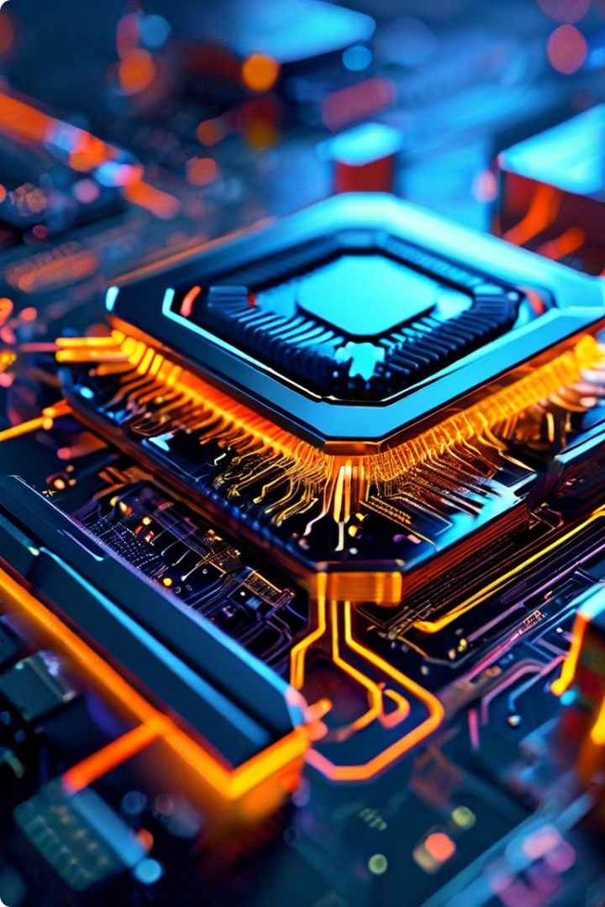
Hardware Powering AI: CPUs, GPUs, and NPUs
AI models are computationally demanding, requiring specialized hardware to handle the complex calculations involved. Different types of processors have emerged to optimize AI performance.
Processor Type
Key Features
Applications
CPU (Central Processing Unit)
General-purpose processor, efficient for sequential tasks.
General computing, system tasks, basic AI tasks.
GPU (Graphics Processing Unit)
Specialized for parallel processing, ideal for AI tasks that involve matrix operations.
Machine learning, deep learning, computer graphics.
NPU (Neural Processing Unit)
Designed specifically for AI workloads, offering high energy efficiency and performance.
Deep learning inference, edge AI applications.

